Slide 1
DevOps Making It Easy to Do the Right Thing
By
Divya Putta,
Nikhila Chinthakindhi,
Saiteja Makani,
Arun

Slide 2
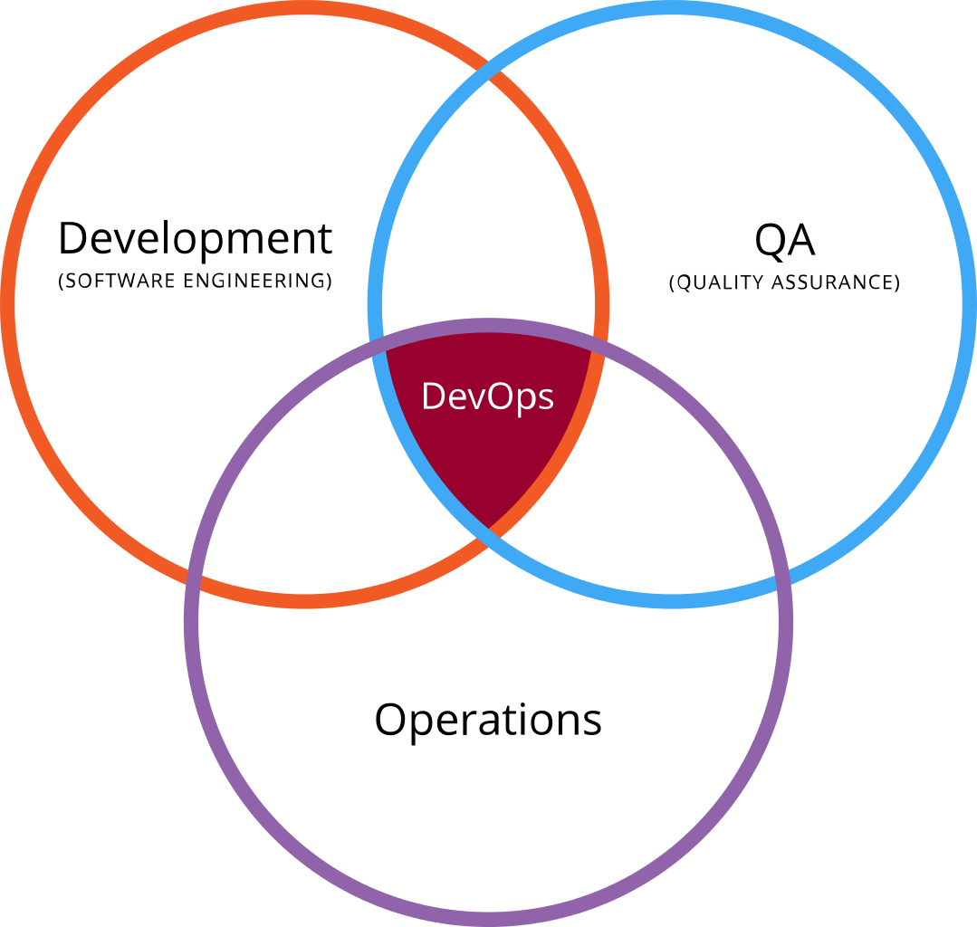
DevOps?
Development
+
Operations
emphasizes the collaboration and communication of both Software Developers and other information-Technology (IT) professionals while automating the process of software delivery and infrastructure changes.

Slide 3
Who Used DevOpps?
Wotif used DevOps principles to recover from the downward spiral of manual release activity. By defining deployment standards for development and operations teams and making them easy to adopt, the company drastically improved the average release cycle time.
Watif??
WOTIF GROUP is one of Australia’s largest travel e-commerce platforms.
In 2013 and 2014,organization overhauled its software release processes,reducing the average releasing time from weeks to hours.

Slide 4
A DevOps and CD transformation enabled this Overhaul.
CD is nothing but Continuous Delivery Transformation.
Wotif faced dilemma on Engineering Departments such as
Infrastructure
Test
Deployment etc.,
To Deal with this,Wotif accept the idea of
“Making It East to Do The Right Thing”

Slide 5


Slide 6
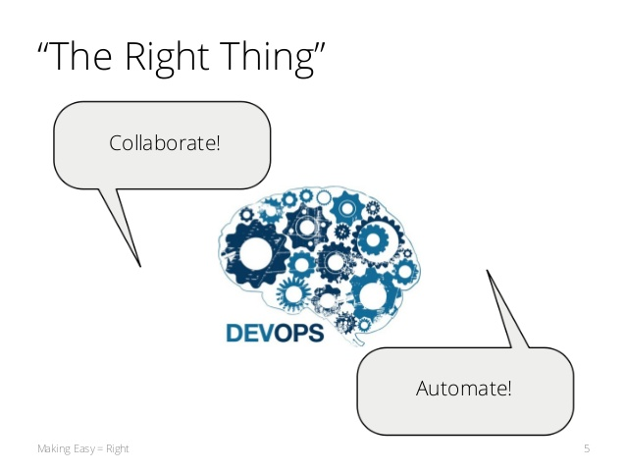
The Right Thing

Slide 7
Making It Easy
Automated Verification
The Reference Implementation
Deployment and Test Automation
Release Independence

Slide 8
Automated Verification
Compliance Test Suite
Bring Operations into Development
Fast Operational Feedback
Test Driven Operational Compatibility
Backwards Compatibility

Slide 9

Reference Implementation
Helloworld-service
Deployed to production

Slide 10
Deployment and Test Automation
Automating Deployment
DevOps tool chain
Rolling upgrade tool
Smoke test script
Release Independence
Versioning
Backward compatibility

Slide 11
SLIPway
Big review of old release processes – Focus on reducing cycle Time
Simple Lightweight Independent Path Way
Simple rules for release Process
Keep changes independent

Slide 12
Simple Rules for SLIPway
Independent
One application per release
Backwards-compatible
No DB/Network/OS changes
No manual testing
Cannot book specific time
Feature switch for time
Ops will service queue within 24 hours
Compliance with latest standards

Slide 13
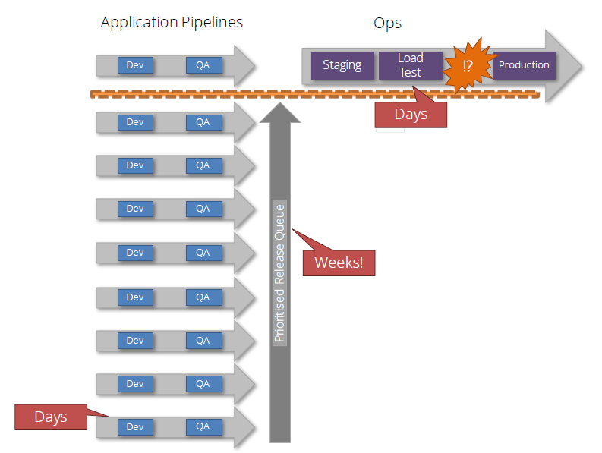
Application pipeline stratagy

Slide 14
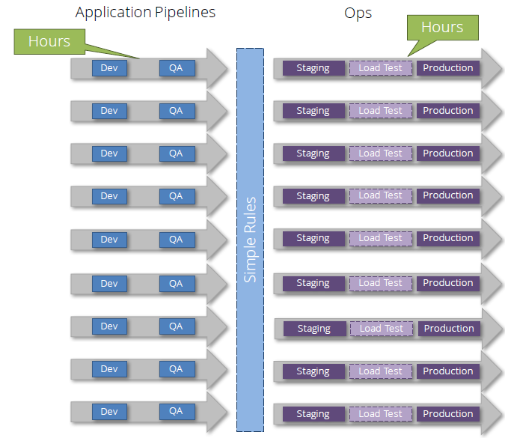
Aplication Pipeline after applying SLIPway rules

Slide 15
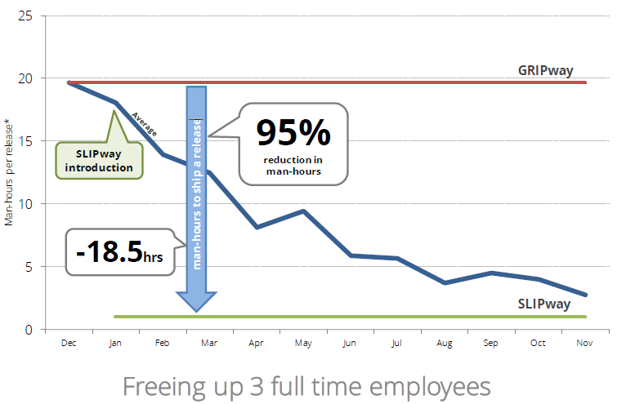
Hours Spent Shipping Release

Slide 16
SUMMARY
SLIP way came into picture by defining the right thing ,proper deployment standards and adaptation through compliance testing.
Deployment automation also enforced for SLIP way.
SLIP way paved path for fast feedback, small batch sizes, and independent releases, emphasizing increased team autonomy.
Below picture shows SLIP way performance.
Releases through SLIP catered needs with average cycle time of 1.1 days per release which is
95 percent reduction in person-hours spent releasing,
86 percent reduction in release cycle time
2.6-fold increase in release count per month

Slide 17
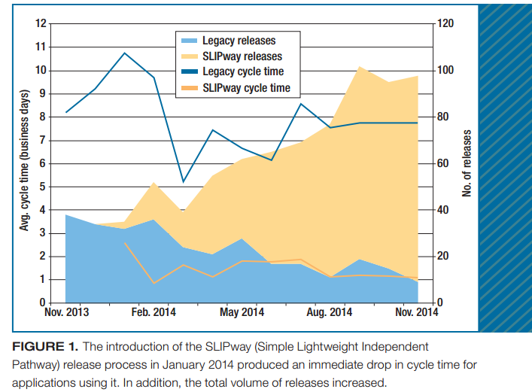
Rates of releases during 2013 and 2014 reduced customer-impacting problem from 15 to 17 after release of CD.

Slide 18
CONTINUOS DEVELOPMENT
With Automated testing and deployment gates, code is released with no manul inteventions.
This is achieved by elevating the permissions of hardened TeamCity agents and building bots.
COSTS
Rolling Upgrade, SLIPway, and continuous deployment required no extra investment in physical infrastructure.
It requires higher head count and hardware investment with CD.

Slide 19
LESSONS LEARNED
Warranty and Adoption Periods
A two week period was introduced to match out between consistent standards and meeting
real-world conditions.
Any revisions could be surfaced during this period before finalizing standards.
For SLIP way , a two-week adoption period before the new standards version after two- week period.
MIGRATION NOTES
Since all developers are not familiar with standards development process and teams applications,
migration notes were provided differentiates previous and steps for updated versions.
SEMANTIC VERSIONING
To avoid developing team spend more days on updating from previous verisons to new versions which
includes data-based versioning with standards- related changes as backward- compatible minor
revisions without forcing to adopt new changes.

Slide 20
REMAINING CHALLENGES
Aligning the Confluence pages, Fabric test suites, reference implementation, and confi- guration management code bases while smoothing the adoption process required signifi cant ongoing coordination.
Not limiting to automation of testing and deployment of the standards , but also standars themselves.
It should be executable documentation in the form of infrastructure as code.
Replacing standards documents with a standardized microservices platform.
Using products such as Mesosphere DCOS is one of remaining challenge to addressed.
Managing database schema upgrades is of utmost priority challenge to be addressed.
Notes:
REMAINING CHALLENGES

